Slide 2
If you are INFORMATIVE it means you are providing useful and interesting information.

Slide 3
In its simplest form, informative writing informs. It is a type of nonfiction writing which means it is all true and factual. You can find informational writing in magazine articles, internet or newspaper articles, textbooks, essays, interviews, government articles, legal documents, and a number of other sources.
As opposed to persuasive writing, informative writing (also called explanatory writing) tries to make the reader UNDERSTAND him or her, not convince. An informative writer will support their thesis (main idea) with evidence and details.

Slide 4
You will be writing an informational essay. You will gather any information, facts or details you may need for the topic.

Slide 5
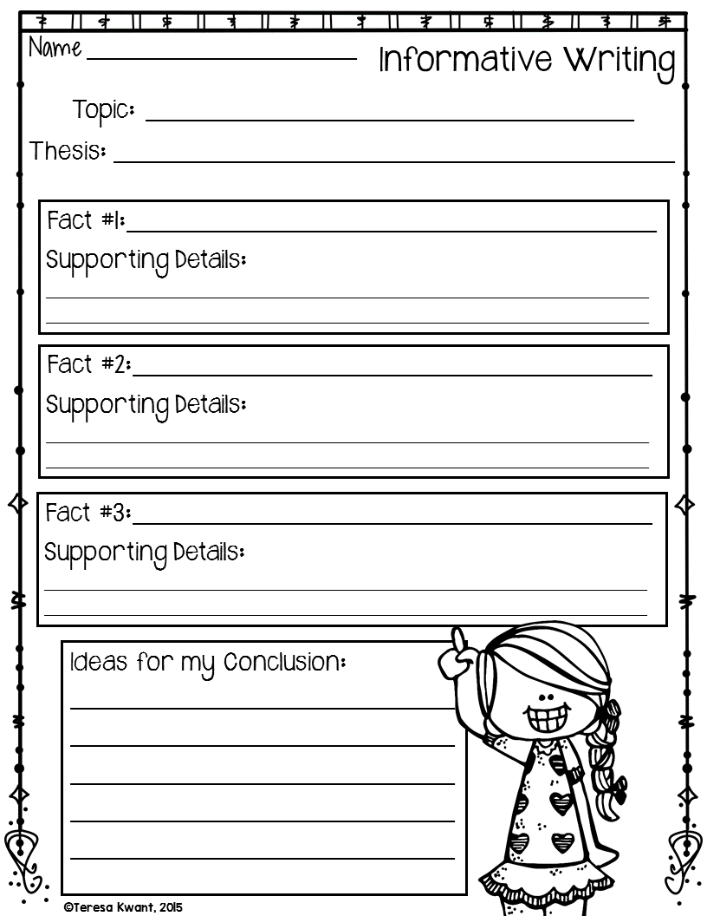
After you choose a topic, write it on your graphic organizer.
For example: All about London, England
Next you will write your thesis. A thesis is your main idea, it is like a topic sentence. It is what your whole essay will be about and will be in your introduction paragraph.
For Example: London, England is a beautiful city located in Europe with many fabulous tourist attractions such as Buckingham Palace, the London Eye, and Big Ben.
Then, you will do some research if needed and find three facts to write about your topic. For each fact you can include supporting details that enhance the fact being discussed.
For Example: Fact #1—Buckingham Palace is the Queen’s official London residence.
Details: Aside from being the Queen’s home, Buckingham Palace is also the office for the Head of State. There are over 800 staff based there.
Fact #2—The London Eye is beautiful way to see London from above.
Detail: This observation wheel rises 443 feet about the river Thames.
Fact #3—Big Ben is an iconic destination spot for many tourists.
Details: This tower measures 318 feet and has a giant clock. The tolling sound is known around the world as the time signal for the BBC radio.
The last thing you will do on your graphic organizer is write any final thoughts or ideas for your concluding paragraph.
For example: London is a city that has history dating as far back as 2,000 years. It is a place that treasures the past but keeps up with the modern world.

Slide 6
You will begin by writing your introduction. You will write your first draft on a writing template provided by Mrs. Price. When writing your introduction remember to make your topic clear and interesting. Stay organized and introduce your ideas that will be presented in your essay in the body paragraphs.
For Example:
Have you ever visited a city that was vastly different from your own? Traveling to different cities can be a fun way to explore the world around you. Europe is often a popular destination for many tourists. London, England is a beautiful city located in Europe with many fabulous attractions such as Buckingham Palace, the London Eye, and Big Ben.
The sentence in teal is my thesis. This is my topic for my entire essay. Body paragraph one will be about Buckingham palace, body paragraph two will be about the London Eye, and body paragraph three will be about Big Ben.

Slide 7
When writing your body paragraphs, this is where you will go into detail about your facts that explain your informational topic. You will have introduced your facts in your introduction. Each body paragraph will focus on ONE fact with supporting details.
For Example:
The number one top destination for visitors in London is Buckingham Palace. Boasting 775 rooms and being the Queen’s official residence, it is definitely a site to remember. Buckingham Palace has a 40 acre garden! It includes items such as a helicopter landing pad, lake, tennis court, and 350 different types of wild flowers. The most iconic spot in London is definitely Buckingham Palace.
Since in my thesis in my introduction paragraph I mentioned Buckingham Palace first, my first body paragraph centered all on the Palace. I kept my facts and details to one idea: Buckingham Palace. Body paragraph two would be about the London Eye and body paragraph three would be about Big Ben (the order I introduced those facts in my thesis).

Slide 8
Your conclusion paragraph is important because it is the last writing your reader will see. This is where you can make a lasting impression. Write your final thoughts here about the topic.
For Example:
Whether London is thousands of miles away from home, or just a few hours, it is a city full of history, fun, and enchantment. Experiencing it first hand will never to be forgotten. London has something for everyone.

Slide 9
Remember, this is a report to INFORM. Facts are important to informative writing because they are the basis of your report. Here are 5 things to remember when you write your informative essay:
#1: Why are you writing this essay? There should always be a “point” to your writing. This essay will be to inform. What are you specifically writing about? Pick a topic and STICK to it.
#2: This is not an opinion writing piece. Keep your opinion, and feelings about the topic, to yourself. You are not persuading someone to like your information, you are just telling and explaining about a topic. You should obviously pick a topic you want to write about, but write with the facts and let the reader form an opinion about the matter.
#3: Use the right facts. Informative writing is all about the facts, however you need to check your sources to make sure your facts are right. While the internet may be a great place to find information, there is also a lot of false facts floating around. Make sure your sources are good and reliable.
#4: Use an active voice. Present your ideas in a strong voice using adjectives that show imagery and make your writing pop. Change out any boring or overused words with interesting ones. You are not trying to be “flowery” but you do want to be interesting.
#5: Write about something that interest you. If you don’t enjoy the topic you are writing about, chances are your reader wont either. Make sure you are excited about the topic and can find something interesting to say about it.

Slide 10
Once your writing rough draft is complete, you will do a self edit. Use this checklist to fix all mistakes and make corrections. This is al so you r time to re-read your essay and add or delete any information.

Slide 11
Once you are done doing a self edit, you will have a peer edit done on your paper. Switch essays with a partner and follower the COPS format when peer editing your partner’s paper. Also try and give one or two compliments about what you liked about their essay.

Slide 12
When you are COMPLETELY finished with your writing, you will publish it. Publishing your paper will mean you write it in your neatest handwriting on a writing template that will look like this:

Slide 13
Your paper will be graded in 4 categories: Content, resources, writing, and bibliography. Each category is worth up to 25 points. Your paper will be worth up to 100 points. Your teacher is the only judge of how many points per category you will receive.

Slide 14
Your final essay is due on April 20, 2018!

